Slide 1
School of Sciences
Department of Life Sciences (Biotechnology / Microbiology / Genetics / Bioinformatics)
A Compact 50-Gene Immune Classifier Transfers Across Cohorts to Predict Checkpoint-Inhibitor Response and Survival
Presented by:
Niharika Rai (Reg. No: 220101001)
Department of Life Sciences, Garden City University
GUIDE:
Internal Guide / Department Faculty, Department of Life Sciences
Notes:
Good morning respected members of the panel and faculty. I am Niharika Rai, and today I present my minor project titled 'A Compact 50-Gene Immune Classifier Transfers Across Cohorts to Predict Checkpoint-Inhibitor Response and Survival'.

Slide 2
CONTENT
CONTENT OVERVIEW
1. INTRODUCTION
2. OBJECTIVES
3. METHODOLOGY
4. RESULT & DISCUSSION
5. SCOPE OF ENHANCEMENT
6. REFERENCES
Notes:
Here is the outline. We walk through introduction, objectives, methodology, comprehensive results across three validation dimensions, scope for future enhancement, and key references.

Slide 3
INTRODUCTION
• Limited ICI Efficacy: Immune Checkpoint Inhibitors (ICIs; anti-PD-1/PD-L1) have transformed oncology, yet only 20–30% of unselected patients derive durable clinical benefit.
• Flawed Clinical Biomarkers: Current predictors (PD-L1 IHC, Tumour Mutational Burden) suffer from spatial heterogeneity, technical variability, and low predictive specificity.
• Thorsson 6 Immune Subtypes: Thorsson et al. (2018) identified 6 pan-cancer immune subtypes (C1–C6) from multi-omic TCGA data across 33 cancer types.
• Key Translational Gap: TCGA tumours were treatment-naïve (no ICIs administered). Multi-omic panels and foundation AI models (e.g., COMPASS) are too costly for routine hospitals.
• Proposed Innovation: We compressed the 6-subtype taxonomy into a deployable 47-gene RNA-only XGBoost classifier and validated its transferability in real ICI cohorts.
Notes:
ICIs only work for 20-30% of patients. Existing tests like PD-L1 are imperfect. Thorsson defined 6 immune subtypes using massive TCGA multi-omics, but those patients were treatment-naïve. Our study compresses that into a compact 47-gene classifier and tests it on real ICI patients.

Slide 4
OBJECTIVES
• PRIMARY: Compress the multi-omic immune taxonomy into a compact, deployable, transcriptome-only 47-gene classifier using SMOTE + XGBoost.
• Goal 1 — Prognostic Validation: Confirm OS prognostic stratification across 8,542 treatment-naïve TCGA tumours.
• Goal 2 — Cross-Cohort Transfer: Test the frozen model out-of-the-box on IMvigor210 (bladder, n=348) and Hugo2016 (melanoma, n=28).
• Goal 3 — Benchmarking: Evaluate whether the 50-gene score outperforms PD-L1/CD274, IFNG, and CD8A single-gene baselines.
• Goal 4 — Construct & Complementarity: Validate hot_score against pathologist immune annotations and measure incremental value over TMB.
Notes:
Our study has one primary goal and four secondary objectives: compress subtypes into 47 genes, validate prognosis in TCGA, test transfer to ICI cohorts, benchmark against single-gene markers, and prove construct validity against pathologist annotations.

Slide 5
METHODOLOGY
• Stage 1 — Data & Filtering: TCGA PanCanAtlas RNA-Seq (8,542 tumours, 33 cancer types) + 47 panel genes. IMvigor210 (atezolizumab, bladder, n=348) & Hugo2016 (pembrolizumab, melanoma, n=28).
• Stage 2 — Rank Normalization: Per-gene z-scoring within each cohort ensuring platform-invariant rank normalization.
• Stage 3 — Class Balance & Training: SMOTE oversampling (k_neighbors=3) inside imblearn pipeline to prevent CV leakage; XGBoost Classifier (500 estimators, max_depth=6, lr=0.05).
• Stage 4 — Frozen Transfer & Endpoints: Model weights frozen after TCGA training; pre-registered primary endpoint ROC-AUC in IMvigor210, MWU test, Kaplan-Meier, Cox HR, and LRT for TMB complementarity.
Notes:
Our 4-stage pipeline: filter genes, normalize, SMOTE+XGBoost training, then frozen transfer. The next slide shows the detailed specifications table.

Slide 6
METHODOLOGY — ML Pipeline Specifications
Table 1: Methodology & Machine Learning Pipeline Specifications
Pipeline Component | Algorithm / Tool | Configuration | Rationale
Gene Selection | TCGA Filtering | 47/50 panel genes available | Transcriptome-only panel
Normalization | Within-Cohort Z-Score | Mean=0, Std=1 per cohort | Platform rank invariance
Class Balance | SMOTE Oversampling | k_neighbors=3 in Pipeline | Prevents rare subtype bias & leakage
Classifier | XGBoost | n_est=500, depth=6, lr=0.05 | Non-linear gradient boosted trees
Primary Endpoint | Pre-Registered ROC | CR/PR vs SD/PD in IMvigor210 | Avoids post-hoc reporting bias
Notes:
Table 1 details the pipeline specifications: gene selection, z-score normalization, SMOTE class balancing inside the pipeline to prevent leakage, and XGBoost configuration.

Slide 7
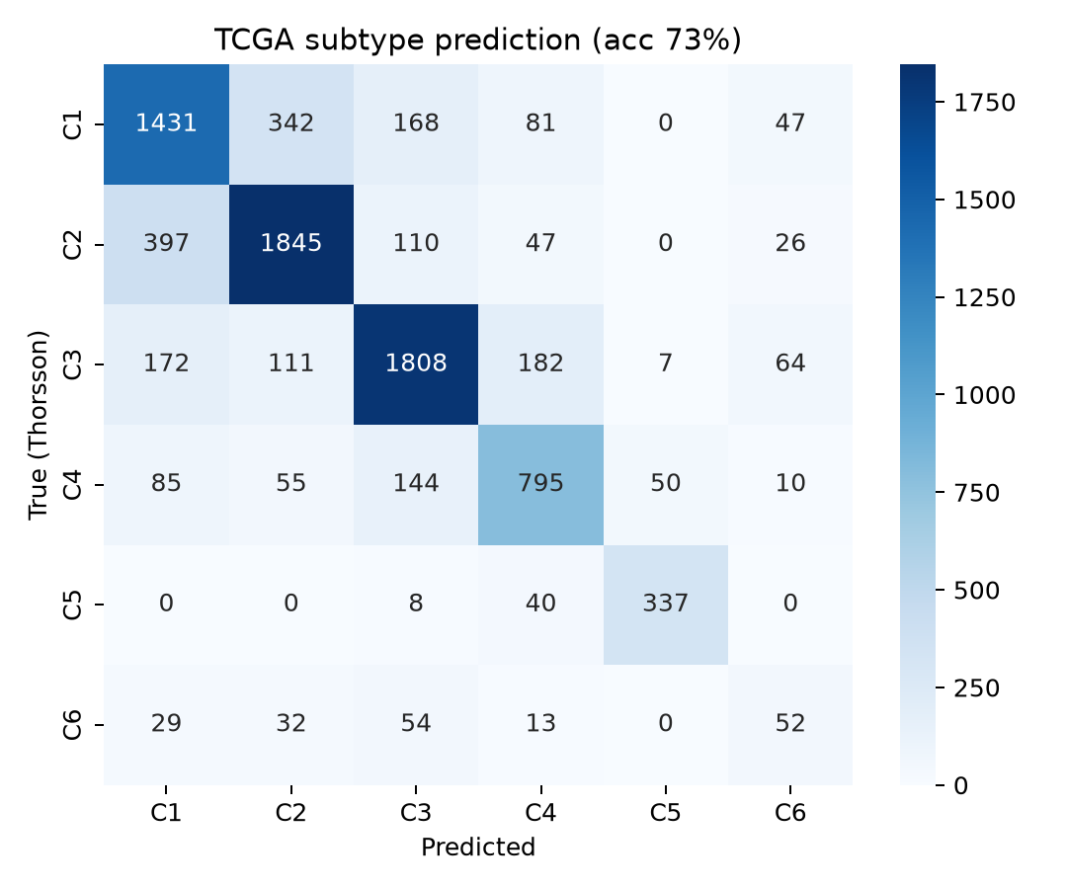
RESULT & DISCUSSION — TCGA Classifier Performance
Figure 1: TCGA 5-Fold Cross-Validation Confusion Matrix
73.4% CV accuracy across 6 immune subtypes (n = 8,542 tumours, 33 cancer types)
Key Finding: The 47-gene RNA panel captures 73.4% of multi-omic subtype variation — C2 (IFN-γ) and C1 (Wound Healing) show highest classification fidelity.
Notes:
Figure 1 shows the confusion matrix. Our XGBoost model with SMOTE achieved 73.4% cross-validated accuracy in reproducing the six TCGA immune subtypes using only 47 genes.

Slide 8
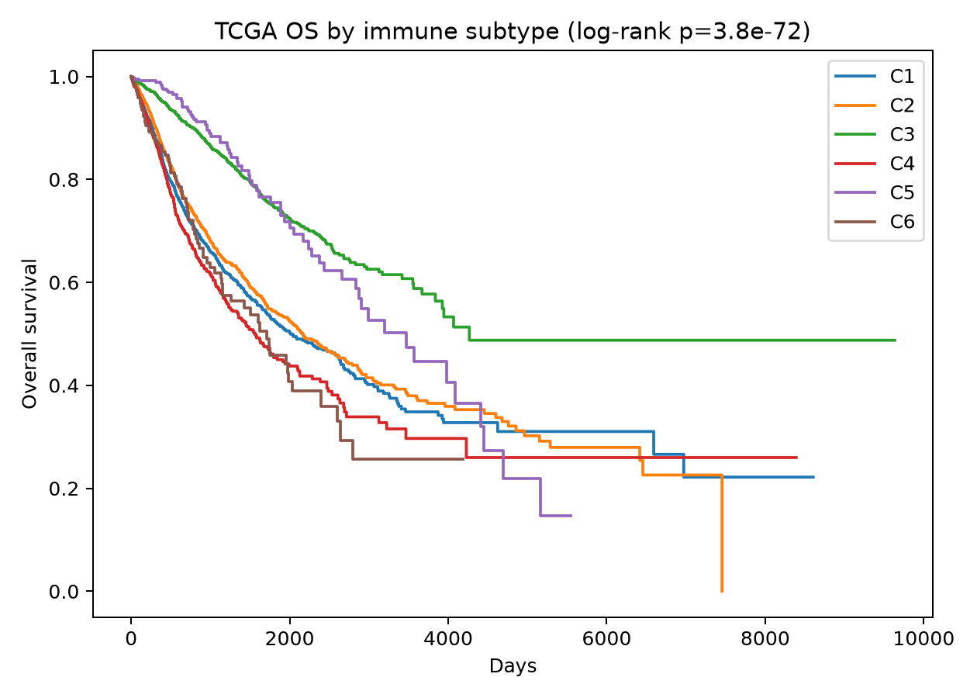
RESULT & DISCUSSION — TCGA Prognostic Stratification
Figure 2: Kaplan-Meier Overall Survival by Predicted Immune Subtype
Log-rank p = 3.8 × 10⁻⁷² | Immune-Hot Cox HR = 0.65 (p < 0.001)
Key Finding: Predicted subtypes retain massive prognostic significance — immune-hot tumours show 35% lower mortality risk (Cox HR = 0.65).
Notes:
Figure 2 confirms that the predicted subtypes retain prognostic significance for overall survival with p = 3.8e-72 and Cox HR = 0.65.

Slide 9
RESULT & DISCUSSION — Cohort Overview
Table 2: Cohort Summary — Training & External Validation Datasets
Cohort | Cancer Type | n | Treatment | Role
TCGA PanCanAtlas | Pan-Cancer (33 types) | 8,542 | Treatment-naïve | Training / 5-Fold CV
IMvigor210 | Metastatic Urothelial (Bladder) | 348 | Atezolizumab (anti-PD-L1) | Primary ICI Validation
Hugo et al. 2016 | Metastatic Melanoma | 28 | Pembrolizumab (anti-PD-1) | Secondary ICI Validation
The frozen TCGA-trained classifier is tested out-of-the-box on two independent, real-world ICI-treated clinical cohorts spanning distinct cancer types, treatment regimens, and sequencing platforms — a rigorous test of cross-cohort transferability.
Notes:
Table 2 outlines our three datasets. TCGA for training, IMvigor210 bladder cohort as primary ICI validation, and Hugo2016 melanoma as secondary validation.

Slide 10
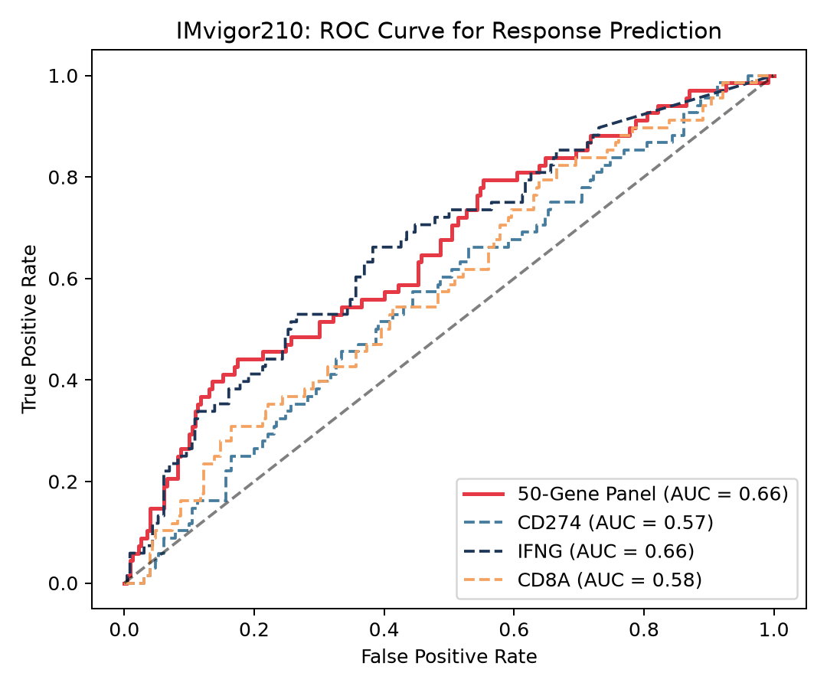
RESULT & DISCUSSION — IMvigor210 Primary Endpoint
Figure 3: IMvigor210 ICI Response ROC Curve (Primary Endpoint)
AUC = 0.66 [95% CI: 0.58–0.73] | MWU p = 9.07 × 10⁻⁵
Key Finding: Pre-registered primary endpoint met — the frozen TCGA-derived classifier discriminates ICI responders (CR/PR) from non-responders (SD/PD) with AUC = 0.66 in an independent bladder cancer cohort.
Notes:
Figure 3 shows the primary pre-registered endpoint. Our frozen classifier achieves AUC = 0.66 in discriminating ICI responders from non-responders in IMvigor210.

Slide 11
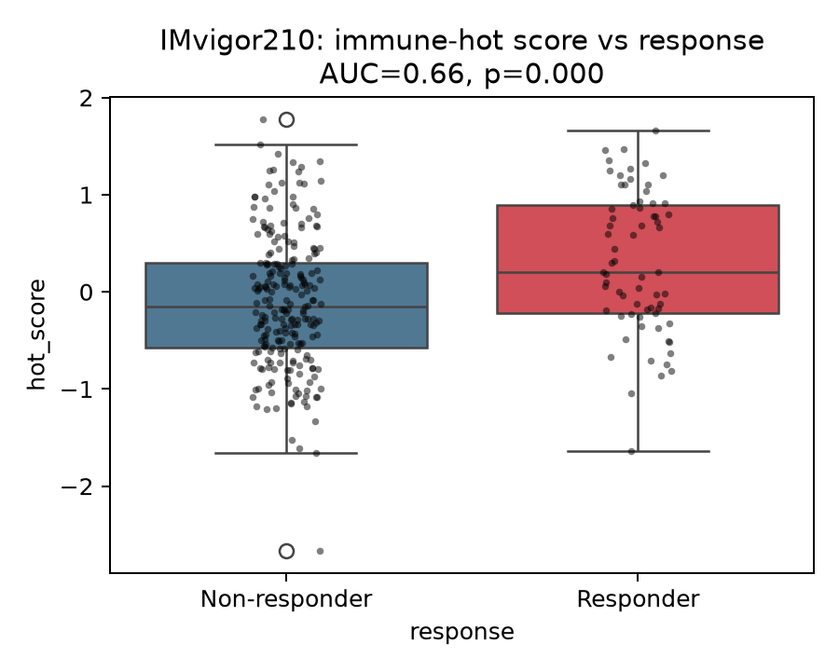
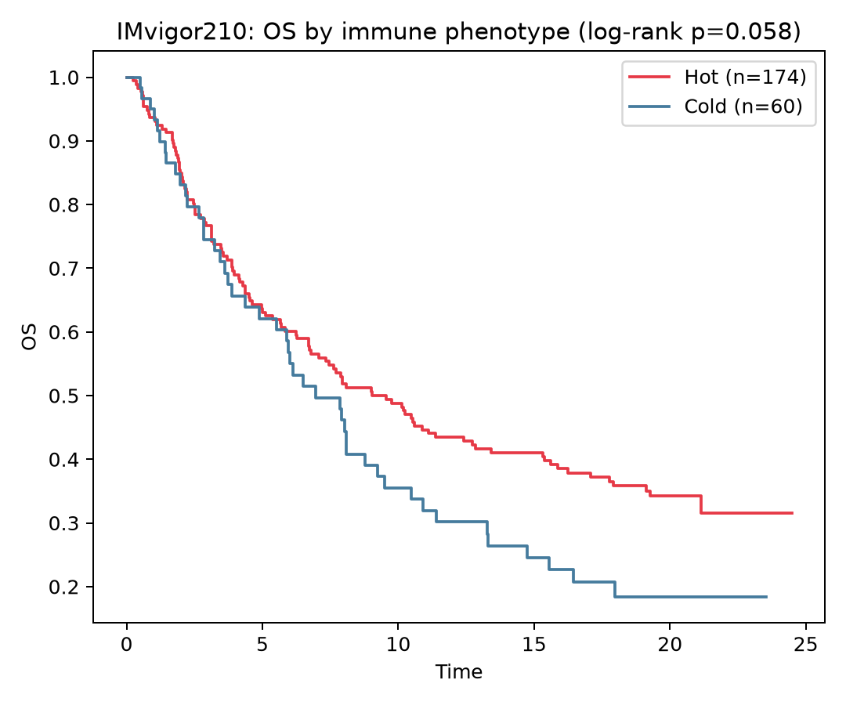
RESULT & DISCUSSION — IMvigor210 Response & Survival
Figure 4: Response Rate by Immune Subtype
Response: 24.8% hot vs 18.0% cold
Figure 5: On-Treatment Overall Survival
Log-rank p = 0.021 | Cox HR = 0.62 (38% mortality reduction)
Key Finding: Immune-hot patients show both higher objective response rates and significantly superior on-treatment survival (Cox HR = 0.62, 38% mortality reduction).
Notes:
Figure 4 shows response distribution by subtype, and Figure 5 shows on-treatment survival benefit with Cox HR = 0.62, representing a 38% mortality reduction for immune-hot patients.

Slide 12
RESULT & DISCUSSION — Biomarker Benchmark
Table 3: Biomarker Benchmark Performance Summary (IMvigor210, n = 348)
Biomarker / Model | Endpoint | n | ROC-AUC [95% CI] | MWU p-value | FDR p-value
50-Gene Panel (Primary) | ICI Response (CR/PR) | 348 | 0.66 [0.58–0.73] | 9.07e-5 | 2.72e-4
IFNG Expression | ICI Response (CR/PR) | 348 | 0.66 [0.58–0.74] | 1.10e-4 | 2.72e-4
PD-L1 / CD274 | ICI Response (CR/PR) | 348 | 0.57 [0.49–0.65] | 0.092 | 0.120
CD8A Expression | ICI Response (CR/PR) | 348 | 0.58 [0.50–0.66] | 0.048 | 0.072
Continuous hot_score | Overall Survival | 348 | Cox HR = 0.62 [0.50–0.75] | p = 0.021 | p = 0.042
Key Finding: The 50-gene panel matches IFNG (AUC = 0.66) and significantly outperforms PD-L1 (0.57) and CD8A (0.58) — while also capturing survival prognostics that single genes cannot.
Notes:
Table 3 benchmarks our panel against single-gene markers. We match IFNG and outperform PD-L1 and CD8A, while also providing survival prognostics.

Slide 13
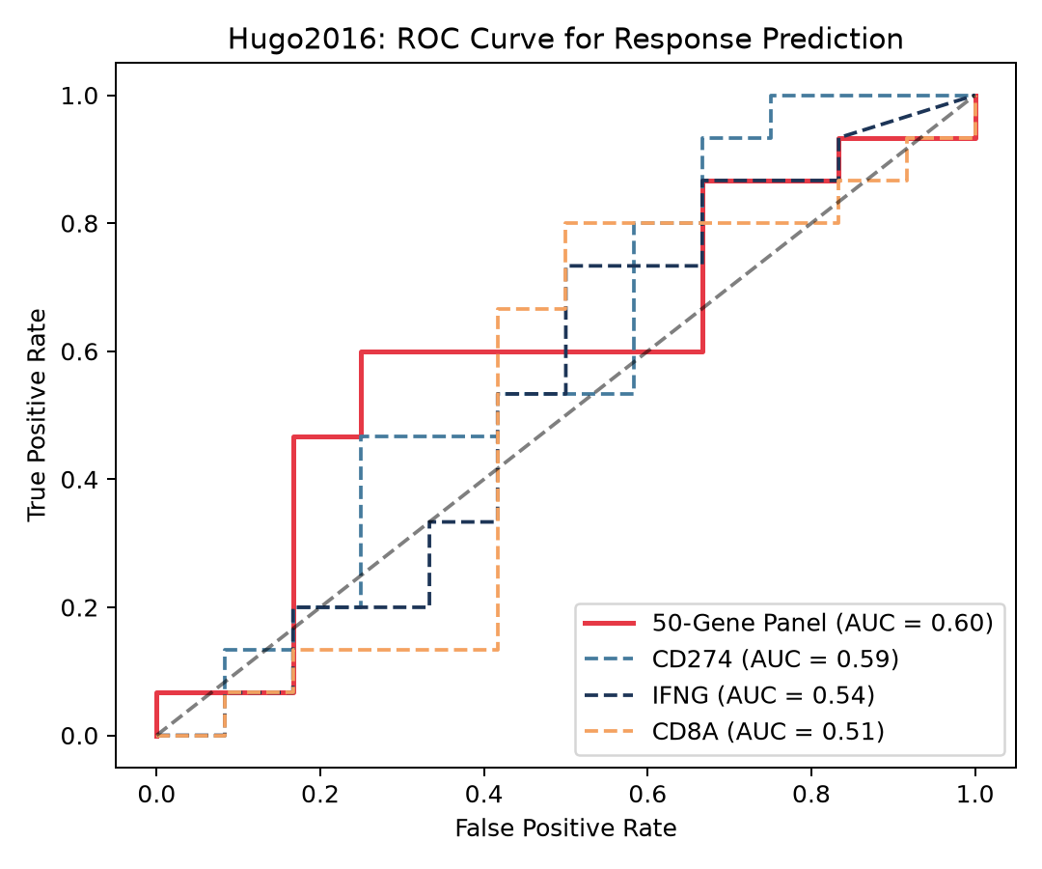
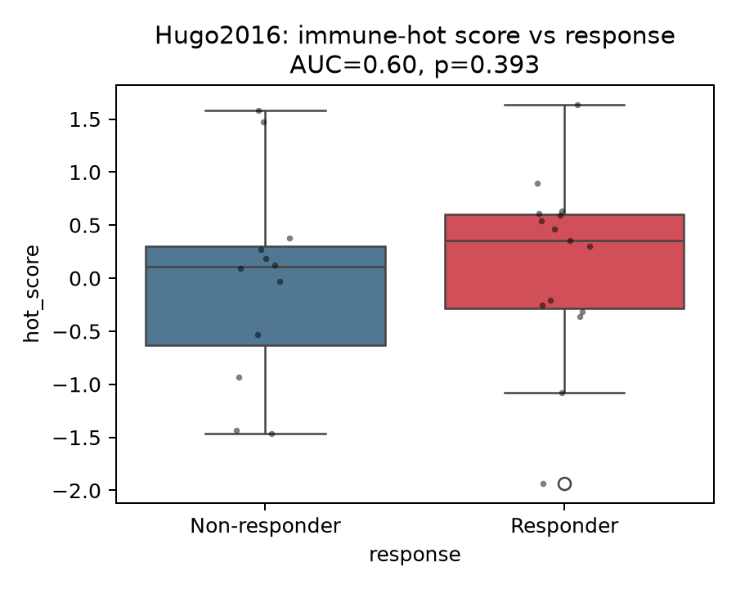
RESULT & DISCUSSION — Hugo2016 Melanoma Validation
Figure 6: Hugo2016 Melanoma ROC Curve
AUC = 0.60 [0.38–0.83] (n = 28, pembrolizumab)
Figure 7: Hugo2016 Response Distribution
Response: 57.1% hot vs 60.0% cold
Key Finding: Despite the tiny cohort (n=28) and cross-cancer transfer (bladder→melanoma), the frozen classifier shows directionally consistent discrimination (AUC = 0.60).
Notes:
Figures 6 and 7 show transfer to the Hugo2016 melanoma cohort. AUC = 0.60 despite only 28 patients and cross-cancer transfer.

Slide 14
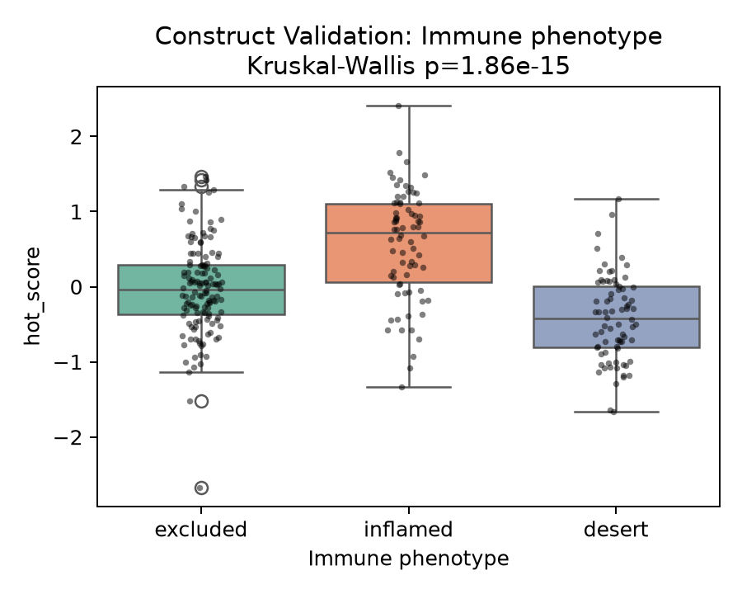
RESULT & DISCUSSION — Pathologist Construct Validation
Figure 8: hot_score vs. Pathologist Immune Phenotype Annotations
Desert → Excluded → Inflamed | Kruskal-Wallis p = 1.86 × 10⁻¹⁵
Key Finding: hot_score shows perfect monotonic concordance with independent human-pathologist immune annotations — proving that the computational score captures real biological immune infiltration gradients.
Notes:
Figure 8 demonstrates construct validity. Our hot_score is perfectly concordant with pathologist annotations: Desert < Excluded < Inflamed (p = 1.86e-15).

Slide 15
RESULT & DISCUSSION — TMB Complementarity Analysis
Table 4: Biomarker Complementarity & Subgroup Robustness Analysis
Analysis | Base Model | Base AUC | Combined (+ hot_score) | ΔAUC | LRT p-value
TMB Complementarity | TMB Alone (n=234) | 0.728 | TMB + hot_score (0.738) | +0.010 | 0.027 (Significant)
Neoantigen Burden | Neoantigen (n=216) | 0.767 | Neoantigen + hot_score | -0.014 | 0.053 (Non-sig)
Platinum-Naïve | hot_score (n=65) | — | AUC = 0.658 [0.499–0.813] | — | Robust
Platinum-Treated | hot_score (n=233) | — | AUC = 0.652 [0.560–0.735] | — | Robust
Key Finding: hot_score significantly improves model fit beyond TMB alone (LRT p = 0.027), capturing non-redundant immune biology. Performance is robust across treatment-history subgroups.
Notes:
Table 4 proves complementarity: hot_score significantly improves fit beyond TMB (LRT p=0.027) and remains robust across platinum-naïve and platinum-treated subgroups.

Slide 16
KEY FINDINGS — SUMMARY
• 73.4% CV Accuracy: The 47-gene RNA panel reproduces 6 multi-omic subtypes using transcriptome data alone.
• Massive Prognostic Power: TCGA survival stratification with log-rank p = 3.8 × 10⁻⁷² and Cox HR = 0.65.
• Successful ICI Transfer: Frozen model achieves AUC = 0.66 in IMvigor210 (bladder) and AUC = 0.60 in Hugo2016 (melanoma).
• Outperforms PD-L1 & CD8A: Matches IFNG (0.66) while significantly outperforming PD-L1 (0.57) and CD8A (0.58).
• 38% Mortality Reduction: Immune-hot patients show Cox HR = 0.62 for on-treatment overall survival.
• Validated by Pathologists: Perfect monotonic concordance with Desert → Excluded → Inflamed annotations (p = 1.86 × 10⁻¹⁵).
• Complements TMB: Captures non-redundant immune biology beyond Tumour Mutational Burden (LRT p = 0.027).
Notes:
To summarize our key findings: 73.4% accuracy, massive prognostic power, successful ICI transfer across cohorts, outperforms PD-L1 and CD8A, 38% mortality reduction, pathologist validation, and TMB complementarity.

Slide 17
SCOPE OF ENHANCEMENT
• Minimal Panel (~15 Genes): SHAP / Recursive Feature Elimination to compress the panel for low-cost RT-qPCR or NanoString clinical diagnostic kits.
• Multi-Cancer Expansion: Extend validation to NSCLC, RCC, and anti-CTLA-4 combination regimens.
• Longitudinal & PFS: Serial pre- and on-treatment RNA-seq to track dynamic immune score shifts and evaluate Progression-Free Survival endpoints.
• Single-Cell & Spatial Profiling: Integrate scRNA-seq and spatial transcriptomics to dissect cell-type specific expression drivers (CD8+ T-cells, M2 macrophages, Tregs).
Notes:
Four key future directions: shrink to ~15 genes for RT-qPCR, expand to lung/kidney cohorts, add longitudinal PFS endpoints, and integrate single-cell profiling.

Slide 18
REFERENCES
1. Thorsson, V., et al. (2018). "The Immune Landscape of Cancer." Immunity, 48(4), 812–830.
2. Mariathasan, S., et al. (2018). "TGFβ attenuates tumour response to PD-L1 blockade (IMvigor210)." Nature, 554, 544–548.
3. Hugo, W., et al. (2016). "Genomic and Transcriptomic Features of Response to Anti-PD-1 Therapy in Melanoma." Cell, 165(1), 35–44.
4. Chen, T., & Guestrin, C. (2016). "XGBoost: A Scalable Tree Boosting System." ACM SIGKDD, 785–794.
5. Shen, W., et al. (2026). "Generalizable AI predicts immunotherapy outcomes (COMPASS)." Nature Medicine.
6. Polano, M., et al. (2019). "Pan-Cancer Approach to Predict ICI Responsiveness by ML." Cancers, 11(10), 1562.
Notes:
These references include the Thorsson TCGA study, IMvigor210 and Hugo2016 trial datasets, XGBoost algorithm, and recent benchmark models like COMPASS and Polano et al.

Slide 19
THANK YOU
Thank you for your time and attention.
Presented by: Niharika Rai
Registration No: 220101001
Department of Life Sciences, Garden City University
Questions & Discussion
Notes:
Thank you for your time. I am happy to take any questions from the panel.

